Slide 1
Periodic properties of elements

Slide 2


Slide 3
Modern Periodic table
Henry Mosley 1913, English physicist based on his work on X-ray spectra
Atomic no is fundamentally proportional to chemical and physical properties
Elements were arranged in increasing order of atomic numbers
Elements with similar properties occupies position in group
Also possible to keep isotopes in periodic table
Also knowns as Modern Periodic table

Slide 4
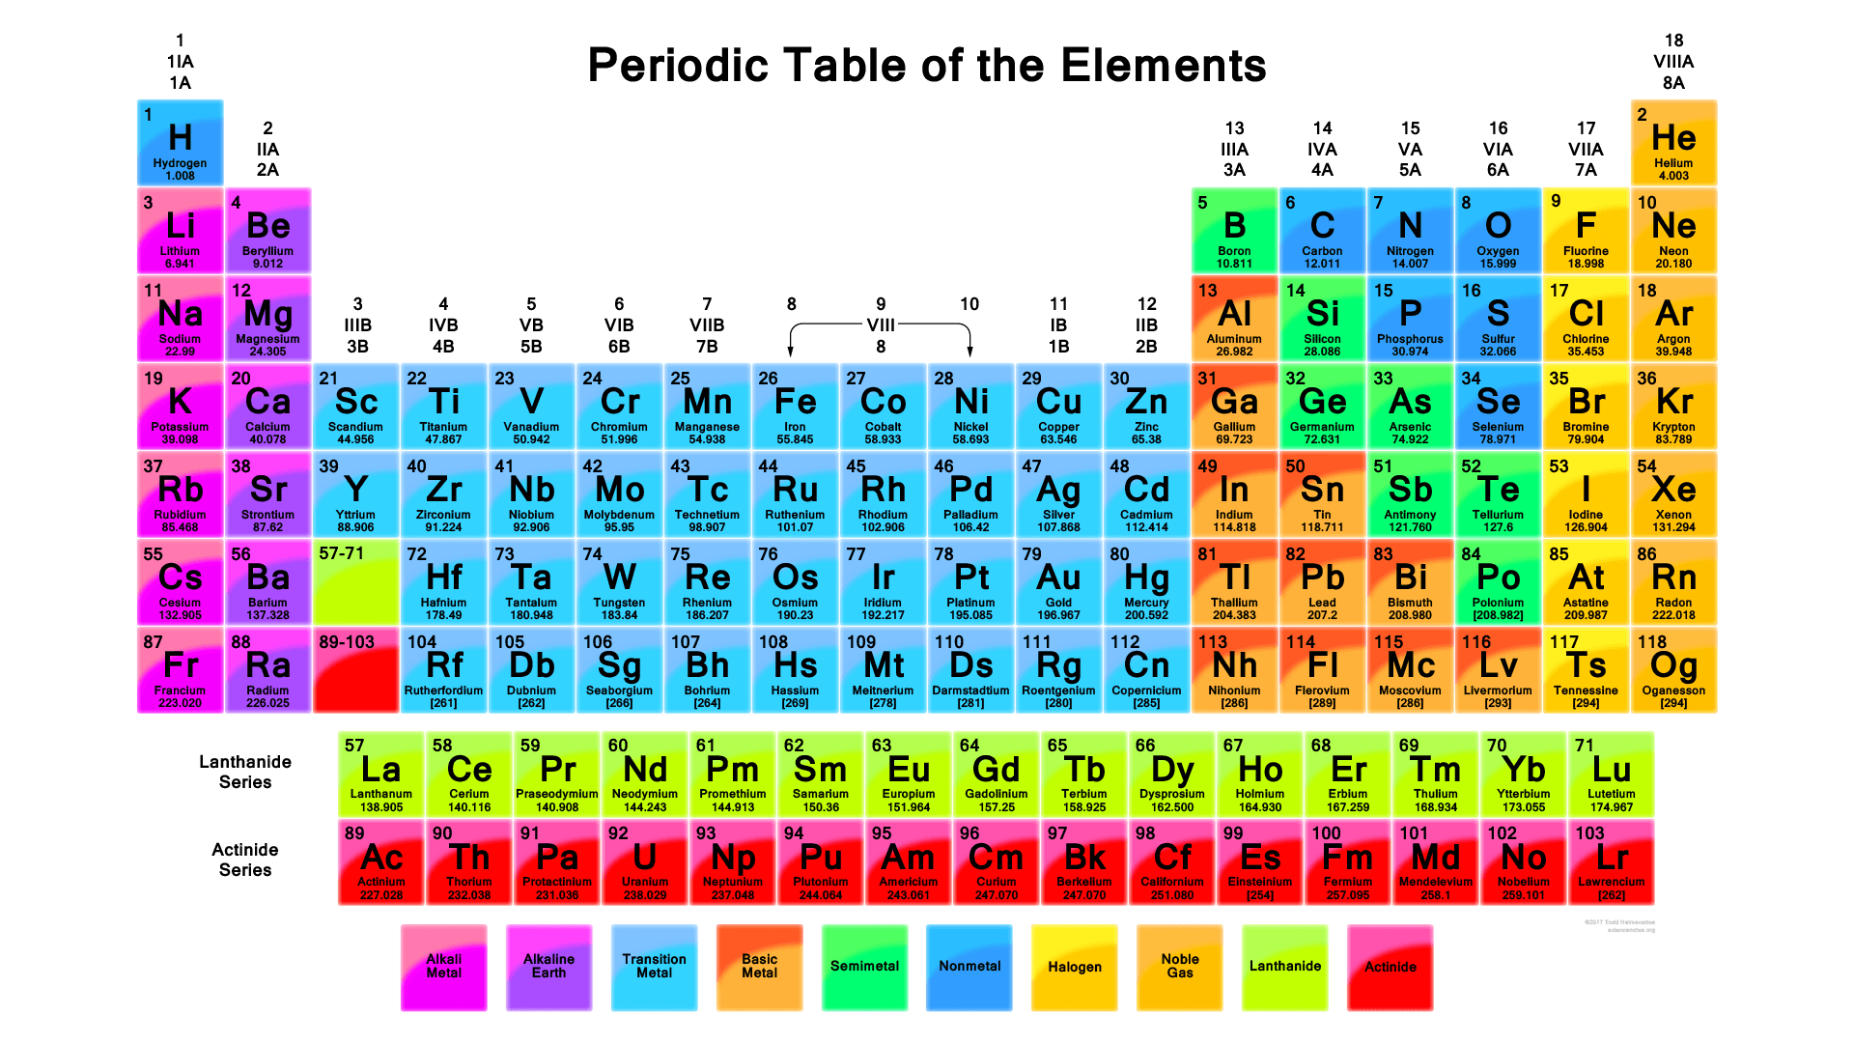
Till date we have 118 elements in periodic table

Slide 5
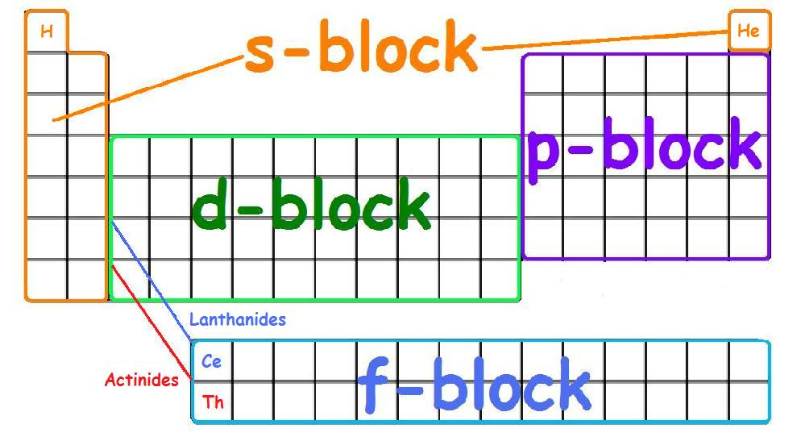
Modern Periodic Table is also referred to as Bohr’s periodic table as elements are arranged in terms of atomic number hence electronic configuration of elements to explain periodicity in their properties.
Modern Periodic table

Slide 6
Prediction of period , block and group of elements
For finding period-
Write the electronic configuration.
Highest value of the principal quantum number will denote the period
Example: Atomic no. 16
Electronic configuration- 1s² 2s² 2p⁶ 3s² 3p⁴
The highest value of principal quantum number = 3
Hence , the element belongs to the third period.

Slide 7
Prediction of period , block and group of elements
For finding block-
Write the electronic configuration.
See the block in which the last electron enters. The element will belong to that block.
Example: Atomic no. 20
Electronic configuration - 1s² 2s² 2p⁶ 3s² 3p⁶ 4s²
The last electron enters in the s block , hence the element belongs to the “s” block.

Slide 8
Prediction of period , block and group of elements
For finding group-
Write the electronic configuration.
For s block- it is equal to the number of electrons in the outermost shell.
For p block- it is equal to the number of electrons in the outermost shell + 10.
For d block- it is equal to the number of electrons in the outermost shell + number of electrons in the penultimate subshell.
Examples : Atomic no. - 12
Electronic configuration- 1s² 2s² 2p⁶ 3s²
Last electron enters in the s block .
Hence, group no.= 2

Slide 9
Prediction of period , block and group of elements
Example : Atomic no. - 21
Electronic configuration- 1s² 2s² 2p⁶ 3s² 3p⁶ 3d¹ 4s²
Last electron enters in the d block( first 4s is filled then 3d).
Hence group no.= 2+1=3
Examples : Atomic no. - 7
Electronic configuration =1s² 2s² 2p³
Last electron enters in the p block .
Hence , group no.= 10+5=15.

Slide 10
Shielding effect
In a multi electron atom the valence shell electrons are attracted by the nucleus and also at the same time repelled by the electrons present between the nucleus and valence shell electrons i.e. the inner shell electrons.
The combined effect of this attraction and repulsion is that the actual force exerted by the nucleus on the valence shell electrons is partially decreased.
Thus the inner shell electrons screen or shield the valence shell electrons from the nucleus.
This decrease in the attractive force exerted by the nucleus because of the inner shell electrons is called shielding or screening effect.

Slide 11
Effective nuclear charge:
The effective nuclear charge is the net positive charge experienced by an electron in a polyelectronic atom.
The decrease in the attractive force exerted by the nucleus because of the inner shell electrons is called shielding or screening effect.

Slide 12
Effective nuclear charge:
Effective nuclear charge can be defined as, the actual nuclear charge Z minus the screening effect caused by the electrons intervening between the nucleus and the outer electrons.
Greater the number of electrons intervening between the nucleus and the outer electrons more will be the magnitude of σ and hence the magnitude of effective nuclear charge Z* will decrease.

Slide 13
Effective nuclear charge:
This shielding effect reduces the nuclear charge. This decreased nuclear charge is called effective nuclear charge and represented as Z*.
Z* = Z – σ
Z = atomic number and σ = screening constant (roughly number of core electrons)
Screening constant is a measure of the extent to which the other electrons in an atom are able to screen the nucleus from the chosen electron.

Slide 14
Effective nuclear charge:
Steps involved
Write the electronic configuration as per the Aufbau’s Principle
Any electrons to the right of the electron of interest do not contribute to shielding constant because they are in the higher shells.

Slide 15
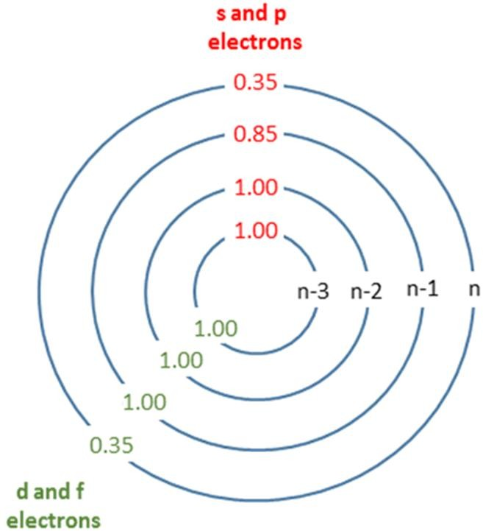
Slater's Rules
Effective nuclear charge:
Step 1: Write electronic configuration.
Then write the electron configuration of the atom in the
following group form:
(1s) (2s, 2p) (3s, 3p) (3d) (4s, 4p) (4d) (4f) (5s, 5p) . . .
Step 2: Identify the electron of interest, and ignore all electrons in higher groups (to the right in the list from Step 1). These do not shield electrons in lower groups
Step 3: Slater's Rules is now broken into two cases: the shielding experienced by an s- or p- electron,
electrons within same group shield 0.35, except the1s which shield 0.30
electrons within the n-1 group shield 0.85
electrons within the n-2 or lower groups shield 1.00
the shielding experienced by nd or nf valence electrons
electrons within same group shield 0.35
electrons within the lower groups shield 1.00
11

Slide 16
Explaining periodicity: Effective nuclear charge and shielding
Inner shell (core) electrons screen the outer (valence) electrons from the nuclear attraction
Shielding is more effective/ strong for electrons with higher angular momentum (higher l value: 3d > 3p > 3s)
Decreases as the valence shell fills
Increased shielding means lower effective nuclear charge

Slide 17
Effective nuclear charge:
The shielding constant for each group is formed as the sum of the following contributions:
Each other electron in the same group (ex. s or p) as the electron of interest shield to an extent of 0.35 nuclear charge units except 1s group, in which the other electron contributes only 0.30.
If the group is of [s, p] type, an amount of 0.85 from each electron in (n-1)^{th} shell and an amount of 1.00 for each electron from (n-2)^{th} and lower shells is added to the shielding constant.
If the group is of [d] or [f] type, an amount of 1.00 for each electron from all lying left to that orbital.

Slide 18
Effective nuclear charge (Example):
(a)Calculate effective nuclear charge in Nitrogen for 2p electron.
Electronic configuration- (1s²) (2s², 2p³).
Screening constant, σ = (0.35 × 4) + (0.85 × 2) = 3.10
Effective nuclear charge, Z* = Z – σ = 7 – 3.10 = 3.90

Slide 19
Effective nuclear charge (Example):
(b)Calculate effective nuclear charge and screening constant seen in 3p electron in Silicon.
Electronic configuration- (1s²) (2s², 2p⁶)(3s², 3p²).
σ = (0.35 × 3) + (0.85 × 8) + (1 × 2) = 9.85
Z* = Z – σ = 14 – 9.85 = 4.15

Slide 20
Effective nuclear charge (Example):
(c)Calculate effective nuclear charge in Zinc for 4s electron & for 3d electron. Electronic configuration- (1s²) (2s², 2p⁶)(3s², 3p⁶)(3d¹⁰)(4s²).
For 4s electron,
σ = (0.35 × 1) + (0.85 × 18) + (1 × 10) = 25.65
Z* = Z – σ = 30 – 25.65 = 4.35
For 3d electron,
σ = (0.35 × 9) + (1 × 18) = 21.15
Z* = Z – σ = 30 – 21.15 = 8.85

Slide 21
Explaining periodicity: Effective nuclear charge and shielding
Inner shell (core) electrons screen the outer (valence) electrons from the nuclear attraction
Shielding is more effective/ strong for electrons with higher angular momentum (higher l value: 3d > 3p > 3s)
Decreases as the valence shell fills
Increased shielding means lower effective nuclear charge

Slide 22
Periodicity
The effective nuclear charge of an atom increases with increasing atom number and with decreasing atomic radius as you go across a period.
As we move down the group the electrons are added to a new orbital which increases the atomic size of the atom, and reduces the influence of the nucleus on the outermost electron, hence we observe a decreased value of the effective nuclear charge.
Note: If we calculate from slaters rule it is observed that down the group ENC change marginally, hence we can say in a group from top to bottom ENC almost remains constant.

Slide 23
Atomic Radii - Concept and periodicity
The absolute size of an atom is difficult to define as the electronic probability distribution is never zero even at far away distances from the nucleus.
Generally the radius of atom or an ion is defined as the distance from the centre of the nucleus to the outermost shell of atom or an ion.
As it is impossible to isolate an individual atom, it is assumed that atoms behave as perfect hard spheres.

Slide 24
Atomic Radii - Concept and periodicity
In a homonuclear diatomic molecules two such spheres are just in contact with each other. The distance between the centres of two atoms i.e. internuclear distance (bond length) in a molecules can be measured by X-Ray and spectral studies. So the radius of an atom is one half of the distance between the centres of the two atoms.

Slide 25
Atomic Radii - Concept and periodicity
The size of an atom decreases from left to right across the periodic table. For eg as we move from Li {Z =3 } to F (Z=S), electrons are added to the same valence shell, as a consequence atom will contract in size.
The size of atom increases from top to bottom in a group this is due to addition of new
Elements | Li | Be | B | C | N | O | F
Atomic radius (pm) | 152 | 111 | 88 | 77 | 70 | 66 | 64
Nuclear charge (Z) | (+3) | (+4) | (+5) | (+6) | (+7) | (+8) | (+9)
Effective Nuclear charge (Z*) | 1.3 | 1.95 | 2.60 | 3.25 | 3.90 | 4.55 | 5.20
Electronic configuration | 1s²2s¹ | 1s²2s² | 1s²2s²2p¹ | 1s²2s²2p² | 1s²2s²2p³ | 1s²2s²2p⁴ | 1s²2s²2p⁵
Notes:
Q. What will happen to ionic radius of 2nd period elements???? justify
Q.2 what will happen to ionic radius down the group??? justify

Slide 26
Atomic Radii - Concept and periodicity
Periodicity in atomic radii:
As we move from left to right say Li (Z =3) to F (Z=9), electrons are added to the same valence shell. Also, the screening constant is same for all electrons in the same valence shell. So the value of Effective Nuclear charge will increase from left to right (as Z value increases but sigma is constant) i.e the positive attraction experienced by the nucleus will increase from left to right in the period and as a consequence atom will contract in size.
Elements | Li | Be | B | C | N | O | F
Atomic radius (pm) | 152 | 111 | 88 | 77 | 70 | 66 | 64
Nuclear charge (Z) | (+3) | (+4) | (+5) | (+6) | (+7) | (+8) | (+9)
Effective Nuclear charge (Z*) | 1.3 | 1.95 | 2.60 | 3.25 | 3.90 | 4.55 | 5.20
Electronic configuration | 1s²2s¹ | 1s²2s² | 1s²2s²2p¹ | 1s²2s²2p² | 1s²2s²2p³ | 1s²2s²2p⁴ | 1s²2s²2p⁵

Slide 27
The size of atom increases from top to bottom in a group this is due to addition of new electrons in newer shells. Eg. Li (Z =3) to Cs (Z=55)
Elements of group I | Atomic radius (pm) | Nuclear charge (Z) | Effective Nuclear charge (Z*) | Electronic configuration
Li | 152 | 3 | 1.3 | 1s²2s¹
Na | 186 | 11 | 2.2 | 1s²2s²2p⁶3s¹
K | 231 | 19 | 2.2 | 1s²2s²2p⁶3s²3p⁶4s¹
Rb | 244 | 37 | 2.2 | 1s²2s²2p⁶3s²3p⁶4s²3d¹⁰ 4p⁶5s¹
Cs | 267 | 55 | 2.2 | 1s²2s²2p⁶3s²3p⁶4s²3d¹⁰4p⁶5s²4d¹⁰ 5p⁶6s¹
Therefore the Factors affecting Atomic Size are
No. of Shells- atomic size directly proportional to the number of shells i.e as number of shells increase, atomic size increases.
Nuclear charge- atomic size inversely proportional to the Nuclear charge

Slide 28
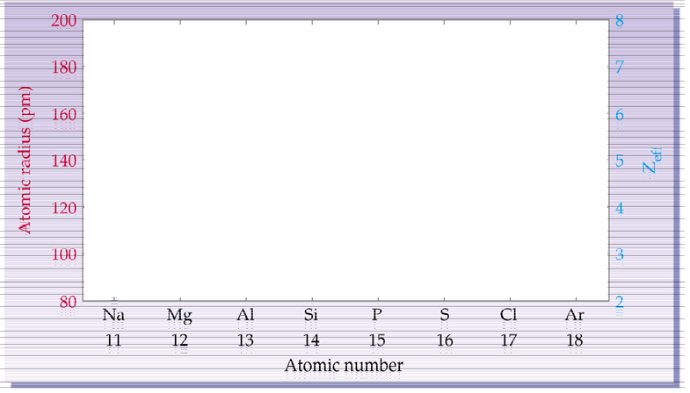
How will the trend in atomic radius and effective nuclear charge (Z_{eff}) across a period. Show in the below chart ?

Slide 29
Correlating atomic radius and effective nuclear charge (Z_{eff}) across a period

Slide 30
Iso electronic species
The iso electronic species are those which have the same number of electrons
Size of isoelectronic cationic species decreases with increase in atomic number
As atomic number increases the nuclear charge increases and the nuclear charge acts on same number of electrons in species and therefore size decreases
Anions with greater negative charge will have larger ionic radius , in this case net repulsion of electrons will out weigh nuclear charge and ion size will increase.
O²⁻> F⁻
Among isoelectronic cation and anion , Anions with High charges will have higher radius
O²⁻> F⁻> Na⁺ >Mg²⁺
Ions | Na⁺ | Mg ²⁺ | Al³⁺ | Si⁴⁺
No of electrons | 10 | 10 | 10 | 10
At no( nuclear charge) | 11 | 12 | 13 | 14
Ionic size (pm) | 95 | 72 | 53.5 | 40

Slide 31
Isoelectronic species
Species with the same no. of electrons, but different no. of protons
Ex. F⁻ & Na⁺
10 electrons 10 electrons
9 protons 11 protons
Ex. O²⁻ & F⁻¹
10 electrons 10 electrons
8 protons 9 protons

Slide 32
Ionization energy
It is possible to remove one or more electrons from an atom, ion or molecule provided sufficient energy is given to the system. The ionization energy of an element is defined as the amount of energy required to remove the most loosely bound electron from an atom of the element in the gas phase.
M(g) = M(g)⁺ + e
As I increases, atoms are harder to ionize
Successive ionizations for electrons are represented by I_{i} (i = 1,2,3,…)
I₁ < I₂ < I₃ <…

Slide 33
Periodicity in ionization energy
Within each period for example, Li (Z = 3) to Ne (Z = 10) as atomic size decreases, nuclear charge increases, the ionization energy rises steeply from Li to Ne.
Exception: the irregularity i.e.higher IE value can be explained on the basis of empty,half- filled and completely filled configuration having extra stability as seen for Be which has
filled 2s² orbital and N has half-filled 2p⁵ orbital
Element | Li | Be | B | C | N | O | F | Ne
Radius (pm) | 123 | 89 | 80 | 77 | 74 | 74 | 72 | -
Nuclear charge | +3 | +4 | +5 | +6 | +7 | +8 | +9 | +10
Ionization energy (kJ mol⁻¹) | 520 | 900 | 800 | 1090 | 1400 | 1310 | 1680 | 2080

Slide 34
Periodicity in ionization energy (IE)
Exception: the irregularity i.e. higher IE value can be explained on the basis of empty, half- filled and completely filled configuration having extra stability as seen for Be which has filled 2s² orbital and N has half-filled 2p orbitals.
Element | Li | Be | B | C | N | O | F | Ne
Radius (pm) | 123 | 89 | 80 | 77 | 74 | 74 | 72 | -
Nuclear charge | +3 | +4 | +5 | +6 | +7 | +8 | +9 | +10
Ionization energy (kJ mol⁻¹) | 520 | 900 | 800 | 1090 | 1400 | 1310 | 1680 | 2080

Slide 35
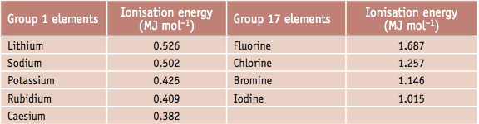
Periodicity in ionization energy (IE)
As we move from top to bottom in a group the IE value decreases. Due to addition of new electrons in newer shells, distance between nucleus and the valence electrons increases, therefore less energy is required to expel the valence electron as the attractive force of the nucleus is less.

Slide 36
Electron Affinity (EA)
The electron affinity of an atom is defined as, change in energy (energy released or spent) when an electron is added to neutral gaseous atom to form a negative ion. OR the amount of energy liberated when an electron is added to a neutral atom to form a negatively charged ion
X(g) + e⁻ → X(g)⁻The electron affinity is a measure of the attraction between the incoming electron and the nucleus - the stronger the attraction, the more energy is released.

Slide 37
Electron Affinity (EA)
When an electron is added to a neutral atom with ease (i.e., first electron affinity) energy is released; thus, the first electron affinity is negative.
First Electron Affinity (negative energy because energy released):
X_{(g)}+e⁻→X⁻_{(g)}

Slide 38
Electron Affinity (EA)
However, more energy is required to add an electron to a negative ion
(i.e., second electron affinity) which overwhelms any the release of energy from the electron attachment process and hence, second electron affinities are positive.
Second Electron Affinity (positive energy because energy needed is more
than gained):
X⁻_{(g)}+e⁻→X²⁻_{(g)}

Slide 39
Periodicity in Electron Affinity (EA)
Within each period for example, Li (Z = 3) to F (Z = 9) the size of atom decreases and their nuclear charge increases, both these factors favour increase in electron affinity.
As we move from top to bottom in a group the EA value decreases.

Slide 40
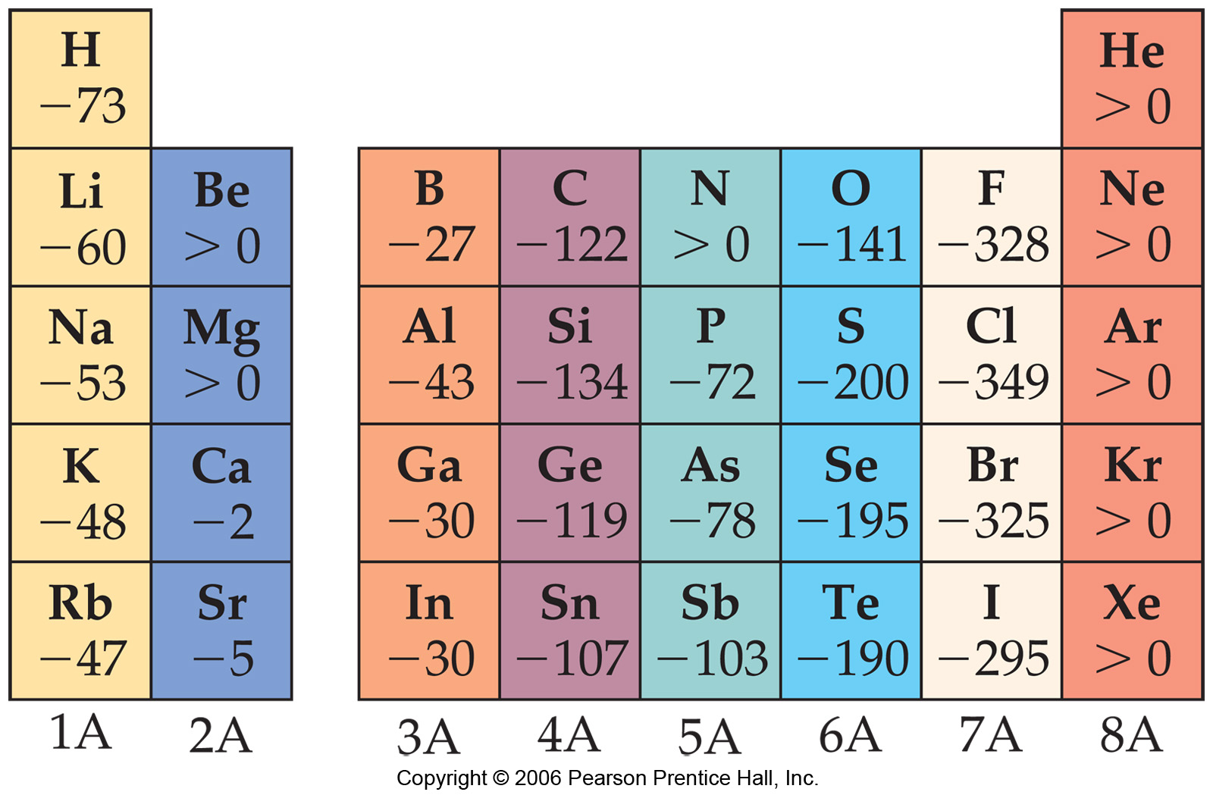
Electron Affinity (EA)
_
Exception: In halogens group 17,the low value of EA of F (-328Kj/mole) relative to that of Cl (- 349KJ/mole) is due to the strong inter electronic repulsion in the relatively small and compact 2p orbital of F on the addition of another electron.

Slide 41
Electronegativity
Electronegativity is defined as a measure of the ability of an atom in a molecule to attract the shared electron pair towards itself.
In a homonuclear diatomic molecule such as H₂ and Cl₂ the shared electron pair is attracted equally by both the bonding atoms and there is no net polarity in the molecule.
H 2.2 |  |  |  |  |  |  | He -
Li 1.0 | Be 1.5 | B 2.0 | C 2.5 | N 3.1 | O 3.5 | F 4.1 | Ne -
Na 0.9 | Mg 1.2 | Al 1.3 | Si 1.7 | P 2.1 | S 2.4 | Cl 2.8 | Ar -
K 0.8 | Ca 1.0 | Ga 1.8 | Ge 2.0 | As 2.2 | Se 2.5 | Br 2.7 | Kr 3.1
Rb 0.8 | Sr 1.0 | In 1.5 | Sn 1.7 | Sb 1.8 | Te 2.0 | I 2.2 | Xe 2.4
Cs 0.7 | Ba 0.9 | Tl 1.8 | Pb 1.8 | Bi 1.7 | Po 1.8 | At 2.0 | Rn -

Slide 42
Electronegativity
This is because the electronegativity of both the atoms is same.
However in a heteronuclear molecule such as HCl the shared electron pair is not equally attracted by the bonding atoms.
H 2.2 |  |  |  |  |  |  | He -
Li 1.0 | Be 1.5 | B 2.0 | C 2.5 | N 3.1 | O 3.5 | F 4.1 | Ne -
Na 0.9 | Mg 1.2 | Al 1.3 | Si 1.7 | P 2.1 | S 2.4 | Cl 2.8 | Ar -
K 0.8 | Ca 1.0 | Ga 1.8 | Ge 2.0 | As 2.2 | Se 2.5 | Br 2.7 | Kr 3.1
Rb 0.8 | Sr 1.0 | In 1.5 | Sn 1.7 | Sb 1.8 | Te 2.0 | I 2.2 | Xe 2.4
Cs 0.7 | Ba 0.9 | Tl 1.8 | Pb 1.8 | Bi 1.7 | Po 1.8 | At 2.0 | Rn -

Slide 43
Electronegativity
The electron pair is shifted more towards Cl than H and the molecule acquires polarity H ^{δ+}…….Cl ^{δ−} . These charges are of equal magnitude but are of opposite sign and the overall charge is zero.
This implies that the Cl is more electronegative than H because it has more electron affinity to complete its octet.
H 2.2 |  |  |  |  |  |  | He -
Li 1.0 | Be 1.5 | B 2.0 | C 2.5 | N 3.1 | O 3.5 | F 4.1 | Ne -
Na 0.9 | Mg 1.2 | Al 1.3 | Si 1.7 | P 2.1 | S 2.4 | Cl 2.8 | Ar -
K 0.8 | Ca 1.0 | Ga 1.8 | Ge 2.0 | As 2.2 | Se 2.5 | Br 2.7 | Kr 3.1
Rb 0.8 | Sr 1.0 | In 1.5 | Sn 1.7 | Sb 1.8 | Te 2.0 | I 2.2 | Xe 2.4
Cs 0.7 | Ba 0.9 | Tl 1.8 | Pb 1.8 | Bi 1.7 | Po 1.8 | At 2.0 | Rn -

Slide 44
Periodicity in Electronegativity
Within each period for example, Li (Z = 3) to F (Z = 9), Electronegativity increases.
H 2.2 |  |  |  |  |  |  | He -
Li 1.0 | Be 1.5 | B 2.0 | C 2.5 | N 3.1 | O 3.5 | F 4.1 | Ne -
Na 0.9 | Mg 1.2 | Al 1.3 | Si 1.7 | P 2.1 | S 2.4 | Cl 2.8 | Ar -
K 0.8 | Ca 1.0 | Ga 1.8 | Ge 2.0 | As 2.2 | Se 2.5 | Br 2.7 | Kr 3.1
Rb 0.8 | Sr 1.0 | In 1.5 | Sn 1.7 | Sb 1.8 | Te 2.0 | I 2.2 | Xe 2.4
Cs 0.7 | Ba 0.9 | Tl 1.8 | Pb 1.8 | Bi 1.7 | Po 1.8 | At 2.0 | Rn -

Slide 45
Periodicity in Electronegativity
As we move from top to bottom in a group for example, Li (Z =3) to Cs (Z=55) Electronegativity decreases. This is due to addition of new electrons in newer shells.
H 2.2 |  |  |  |  |  |  | He -
Li 1.0 | Be 1.5 | B 2.0 | C 2.5 | N 3.1 | O 3.5 | F 4.1 | Ne -
Na 0.9 | Mg 1.2 | Al 1.3 | Si 1.7 | P 2.1 | S 2.4 | Cl 2.8 | Ar -
K 0.8 | Ca 1.0 | Ga 1.8 | Ge 2.0 | As 2.2 | Se 2.5 | Br 2.7 | Kr 3.1
Rb 0.8 | Sr 1.0 | In 1.5 | Sn 1.7 | Sb 1.8 | Te 2.0 | I 2.2 | Xe 2.4
Cs 0.7 | Ba 0.9 | Tl 1.8 | Pb 1.8 | Bi 1.7 | Po 1.8 | At 2.0 | Rn -

Slide 46
Periodicity in Electronegativity
Electronegativities of the main group elements on Pauling scale
H 2.2 |  |  |  |  |  |  | He -
Li 1.0 | Be 1.5 | B 2.0 | C 2.5 | N 3.1 | O 3.5 | F 4.1 | Ne -
Na 0.9 | Mg 1.2 | Al 1.3 | Si 1.7 | P 2.1 | S 2.4 | Cl 2.8 | Ar -
K 0.8 | Ca 1.0 | Ga 1.8 | Ge 2.0 | As 2.2 | Se 2.5 | Br 2.7 | Kr 3.1
Rb 0.8 | Sr 1.0 | In 1.5 | Sn 1.7 | Sb 1.8 | Te 2.0 | I 2.2 | Xe 2.4
Cs 0.7 | Ba 0.9 | Tl 1.8 | Pb 1.8 | Bi 1.7 | Po 1.8 | At 2.0 | Rn -

Slide 47
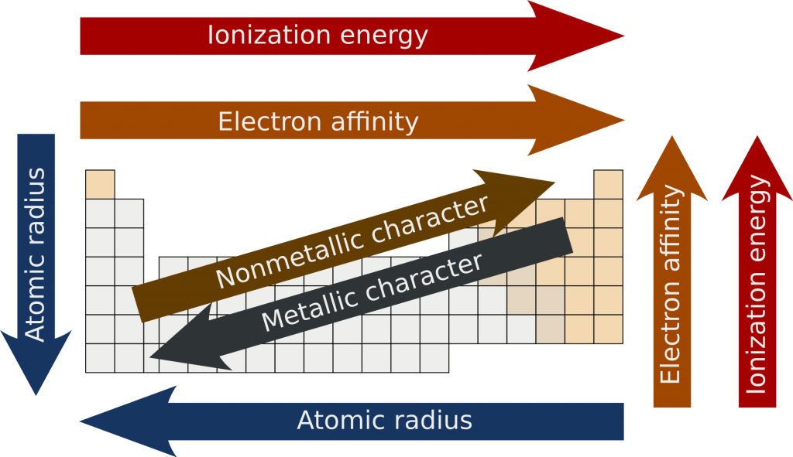
Summary of Periodic properties of elements:

Slide 48
Video links
https://www.youtube.com/watch?v=I5H1SeepnaU
https://www.youtube.com/watch?v=fPnwBITSmgU
https://www.youtube.com/watch?v=6WIBa32o63Q periodic properties electronic affinity,
https://www.youtube.com/watch?v=hePb00CqvP0 periodic properties atomic radius
https://www.youtube.com/watch?v=hs5t-6iq6-c
https://www.youtube.com/watch?v=YGz4YgTTs8Q
https://www.youtube.com/watch?v=hs5t-6iq6-c

